Slide 1
By Jose Braz, Patrick Weifenbach, Sara Brown and Stijn Burgers
By Jose Braz, Patrick Weifenbach, Sara Brown and Stijn Burgers

Slide 2
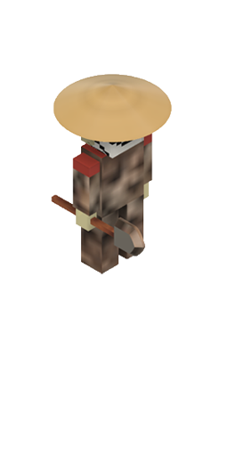
Outline_==--
Outline
The story of the last egg
Specifications
Graphics and animations
Final product / Trailer
Learnings

Slide 3
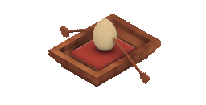
The story of the Last Egg
All Chicken die in a pandemic => no eggs anymore
Therefore the hunt for the last eggs start.
The last egg decides to flee with the help of a human
but because of fragile Egg => need of a boat

Slide 4
Specifications
Godot, GDscript
One player game
2.5D game with a isometric view
High score
Only arrow keys and one more key for every other interaction (F)

Slide 5



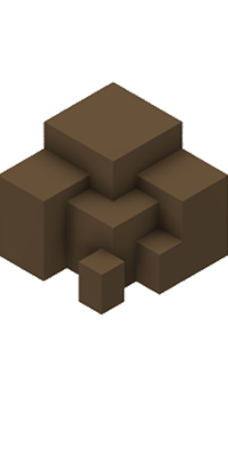
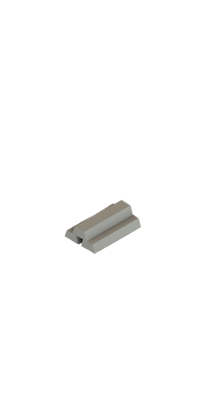
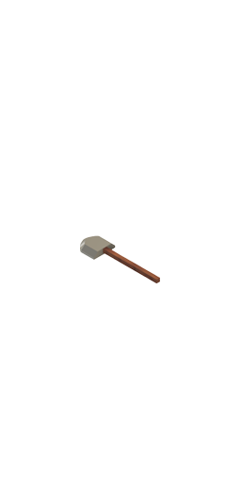
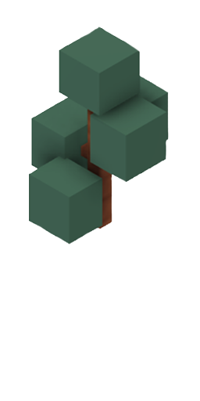
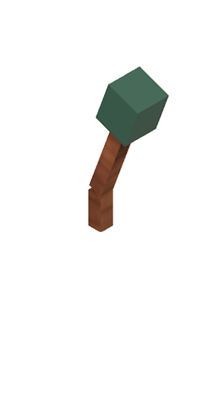
Graphics and animations
Fusion360: 3D models
Adobe Première Pro: transparent GIFs
Adobe Photoshop: PNGs (sprites) compatible for Godot

Slide 6

Final Product / Trailer
Trailer
Walkthrough
What we still wanted to improve

Slide 7
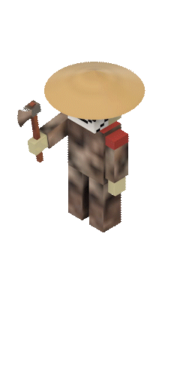
Learnings
There were no tutorials for similar games
We had to be creative
combine a lot of different solutions
Focused on scalability and a working prototype
Single-Player Coop
Straight Channel own Design with Turns
Obstacles (more complex to implement)
Trees
Rocks
Houses
Beavers
Items (equipped by defold)
Shovel
TNT
Gun
Wood
Way more work than expected

Slide 8
Dankeschön, Obrigado, Dankjewel and Tusen takk!
= Thank you

